Slide 1
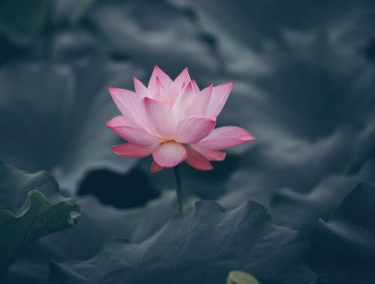
The Lotus
By
Toru Dutt

Slide 2
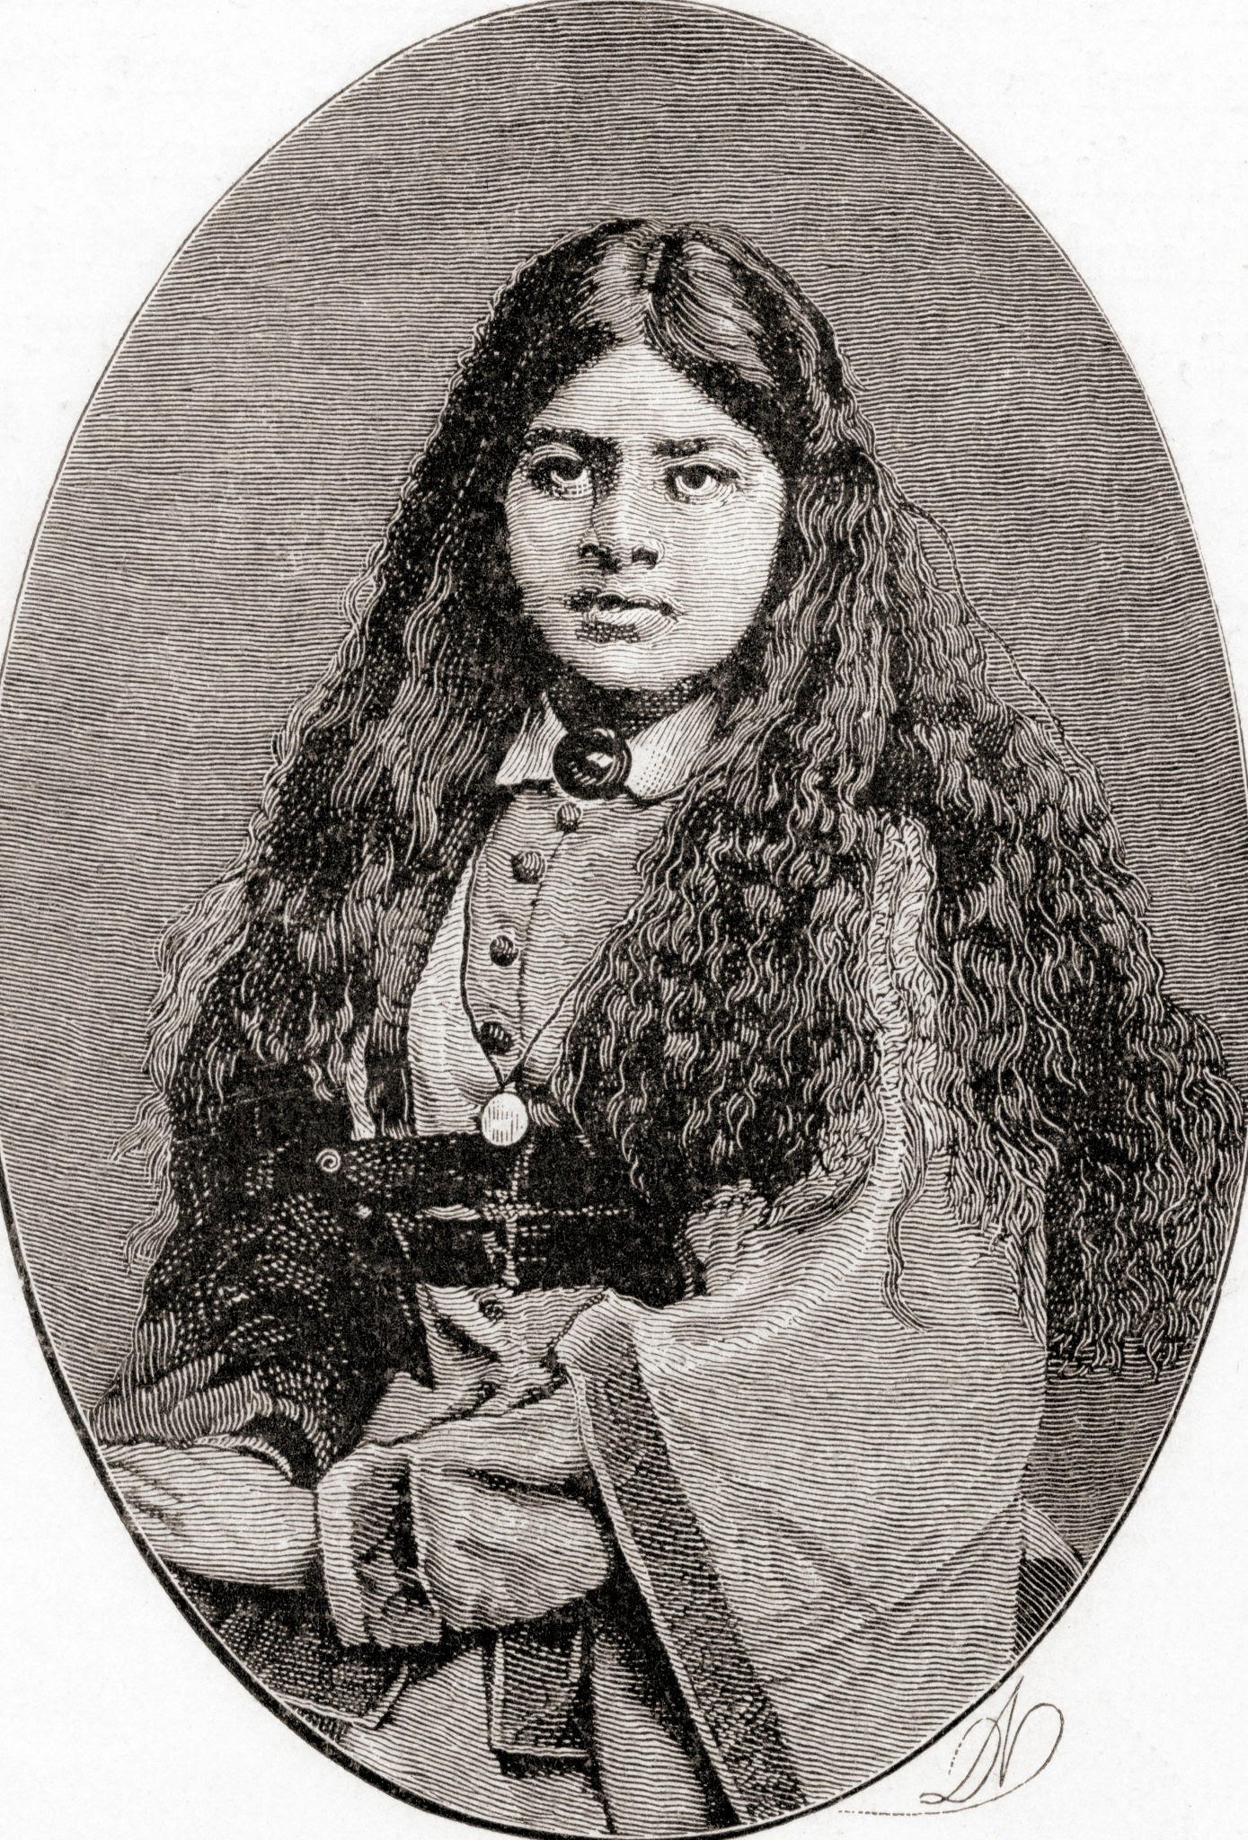
Toru Dutt
Toru Dut (4 March 1856 – 30 August 1877) was a Bengali translator and poet from British India, who wrote in English and French. She is among the founding figures of Indo-Anglian literature, alongside Henry Louis Vivian Derozio (1809–1831), Manmohan Ghose (1869–1924), and Sarojini Naidu (1879–1949).
She is known for her volumes of poetry in English, A Sheaf Gleaned in French Fields (1877) and Ancient Ballads and Legends of Hindustan (1882), and for a novel in French, Le Journal de Mademoiselle d'Arvers (1879). Her poems explore themes of loneliness, longing, patriotism and nostalgia. Dutt died at the age of 21.

Slide 3
The Lotus
Love came to Flora asking for a flower
That would of flowers be undisputed queen,
The lily and the rose, long, long had been
Rivals for that high honour. Bards of power
Had sung their claims. “The rose can never tower
Like the pale lily with her Juno mien”-
“But is the lily lovelier?” Thus between
Flower-factions rang the strife in Psyche’s bower.

Slide 4
“Give me a flower delicious as the rose
And stately as the lily in her pride”-
“But of what colour?”- “Rose-red,” Love first chose,
Then prayed, -“No, lily-white,-or, both provide”;
And Flora gave the lotus, “rose-red” dyed,
And “lily-white,”- the queenliest flower that blows.

Slide 5
Glossary
Flora – Roman goddess of flowers
undisputed – unquestioned
Juno – wife of Jupiter, queen of heaven, goddess of light
mien – appearance, bearing
strife – struggle
psyche- a princess loved by Cupid (the Roman god love)
Rivals – competitor, challenger
Bards – poets
Tower – stand like a tower
Fractions – division, section
Delicious – delightful, pleasant

Slide 6
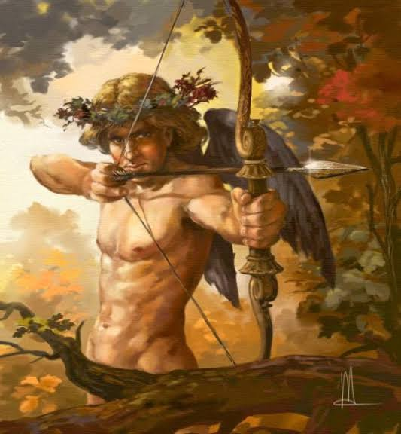
In classical mythology, Cupid (Latin Cupīdō [kʊˈpiːdoː], meaning "passionate desire") is the god of desire, erotic love, attraction and affection. He is often portrayed as the son of the love goddess Venus and the god of war Mars. He is also known in Latin as Amor ("Love").

Slide 7
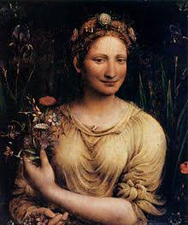
Flora, in Roman religion, the goddess of the flowering of plants. Titus Tatius (according to tradition, the Sabine king who ruled with Romulus) is said to have introduced her cult to Rome; her temple stood near the Circus Maximus.

Slide 8
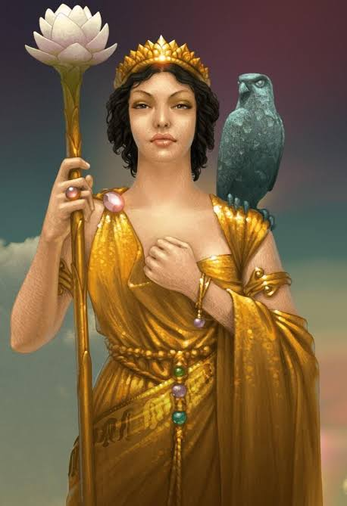
Juno is the ancient Roman goddess of marriage and childbirth. She is also the chief goddess, Roman Queen of the Gods (Regina Deorum) and female counterpart of Jupiter. She is the wife and sister to King Jupiter. Juno is considered as the protector and special counselor of the roman state.

Slide 9
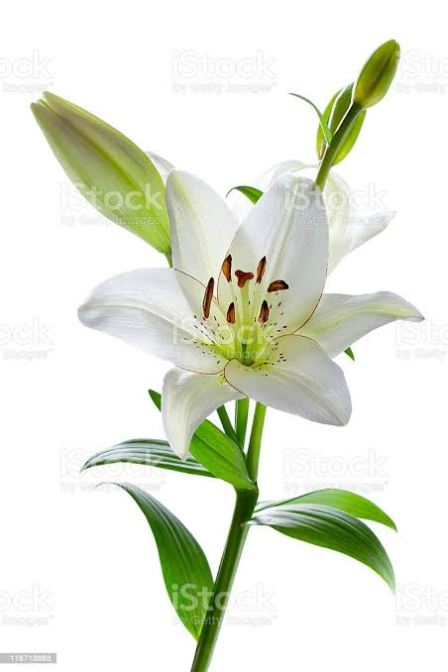
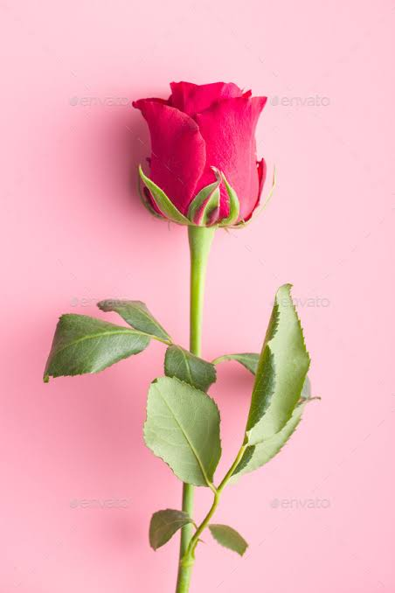
Lily
Rose

Slide 10
Analysis
Love came to Flora asking for a flower
That would of flowers be undisputed queen,
The lily and the rose, long, long had been
Rivals for that high honour. Bards of power
Had sung their claims. “The rose can never tower
Like the pale lily with her Juno mien”-
“But is the lily lovelier?” Thus between
Flower-factions rang the strife in Psyche’s bower.
The first 8 lines describe a situation that arises in Psyche’s bower. A bower is a sheltered, cool part of a garden and is a pleasant area to sit in. Here, Love approaches Flora and asks her for a flower that can be called the queen of all flowers. There are already two flowers vying for this title, that is, the lily and the rose. Many poets (bards) who were highly influential claimed that the rose could never reach the stature of the lily, and the lily could never have the beauty of the rose. Because of these uncertainties, was argument and debate between the two camps, and neither the lily nor the rose came out victorious.

Slide 11
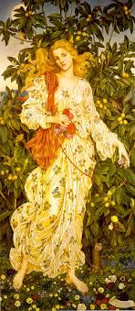
This poet uses several characters from Roman mythology in the story she tells through this poem. Love can be seen as Cupid, the Roman god of love. Flora is the Roman goddess of flowering plants and the season of spring. The Roman goddess Juno is the Queen of the gods, and the Roman goddess Psyche is the wife of Cupid.
The lily is a flower that is native to areas of the Northern Hemisphere, like Europe, or the United States. In the poem, the lily represents the standards of beauty of the West and is symbolic of the belief that their beauty and standards are the best. The lily flower also is compared to the goddess Juno. Juno, as the queen of the gods, is well known for her elegance and majestic looks. The lily’s “Juno mien” is the flower’s own stateliness and sophisticated air. “Mien” means the appearance or demeanour of someone, and in this case, the lily’s mien was one of royalty.

Slide 12
The rose is a flower that is native to Central Asia, and is representative of the opposite of the Euro-centric standards of beauty, and symbolises the natural beauty of those that do not necessarily live up to the standards set by European countries and the like. In poetry, the rose is symbolic of love and beauty, and this beauty is unattainable even to the lily.
The flower garden is at an impasse, as neither candidate for queendom wins over the other. There is strife between these two, in deciding who comes out victorious. In the context of beauty, the strife is between the acceptance of Eurocentric ideals of beauty and the acceptance of Eastern ideals of beauty. Neither win over the other, and must learn to co-exist.

Slide 13
“Give me a flower delicious as the rose
And stately as the lily in her pride”-
“But of what colour?”- “Rose-red,” Love first chose,
Then prayed, -“No, lily-white,-or, both provide”;
And Flora gave the lotus, “rose-red” dyed,
And “lily-white,”- the queenliest flower that blows.
The volta of the Petrarchan sonnet is seen here, as the problem that was brought up earlier gets resolved. Unable to choose between the stately lily and the beautiful rose, Love asks Flora to instead give him a flower that combines the best of both.
This indecision between the lily and the rose is brought forth again when Love was not able to choose a colour. He could not decide between the beautiful rose-red, or the elegant lily-white. He finally hit upon the best compromise, a mix of both.

Slide 14
To fulfil his wish, the goddess provided the lotus flower, a mix of both the rose and the lily, the true queen of the garden. This lotus represents India and the Hindu religion. The poet is portraying the Hindu religion as the one that is superior to all others, as the lotus is superior to all other flowers in Psyche’s garden.
The lotus flower is the national flower of India, and it is also revered by Hindus. Many deities like Saraswati, or Brahma, sit at a throne that is modelled after the lotus flower. It is a symbol of enlightenment and purity and is the expression of the divinity of the gods. Using this lotus, Dutt expresses that the Hindu religion triumphs over all others.
However, this poem is not seen only through the eyes of religion. This intermingling of cultures to bring about a better result is also representative of how the standards of beauty reach a compromise accepted by all. The ideals of both factions are combined as the lily and rose are combined, to create a beauty that emerges from the mix of both.

